Slide 1
Introduction to the Advanced Encryption Standard (AES)
Understanding Symmetric Encryption
Presenter: Hassanein Said ,Ismail Sherif ,Nader Ahmed ,Mina Hany

Slide 2
What is AES?
Definition: AES (Advanced Encryption Standard) is a symmetric encryption algorithm.
Adoption: Standardized by NIST in 2001.
Usage: Widely used in secure communications, file encryption, and data protection.

Slide 3
Key Features of AES
Symmetric Key Algorithm: Same key for encryption and decryption.
Block Cipher: Operates on fixed-size blocks (128 bits).
Key Sizes: Supports 128, 192, and 256-bit keys.

Slide 4
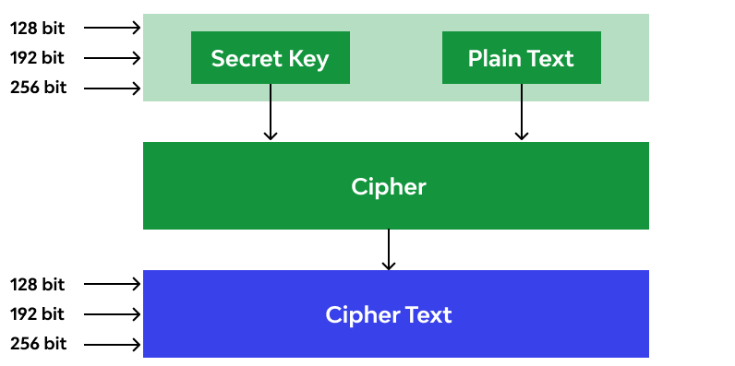
AES Structure
Block Size: 128 bits.​
Key Sizes: 128, 192, and 256 bits.​
Rounds:​
AES-128: 10 rounds​
AES-192: 12 rounds​
AES-256: 14 rounds​

Slide 5
AES Encryption Flowchart Overview
Initial Round: AddRoundKey
Main Rounds: SubBytes, ShiftRows, MixColumns, AddRoundKey
Final Round: SubBytes, ShiftRows, AddRoundKey

Slide 6
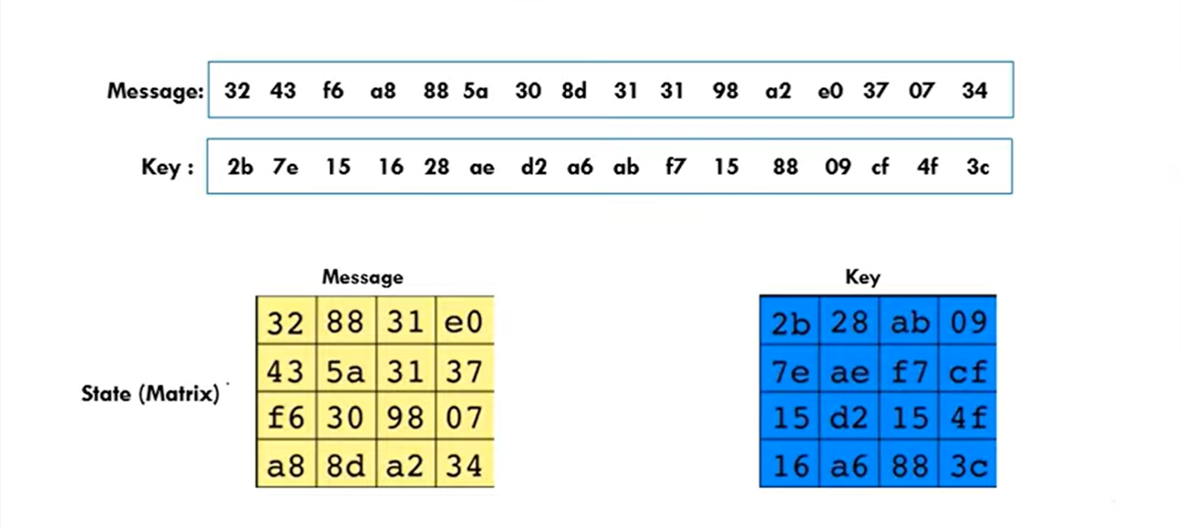
Plantext & key

Slide 7
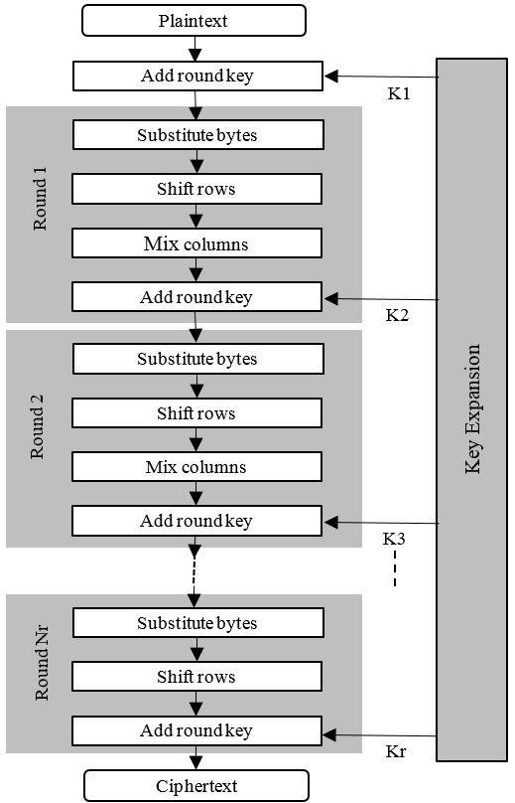
AES Process Content:
Initial Round: AddRoundKey
Main Rounds: SubBytes, ShiftRows, MixColumns, AddRoundKey
Final Round: SubBytes, ShiftRows, AddRoundKey

Slide 8
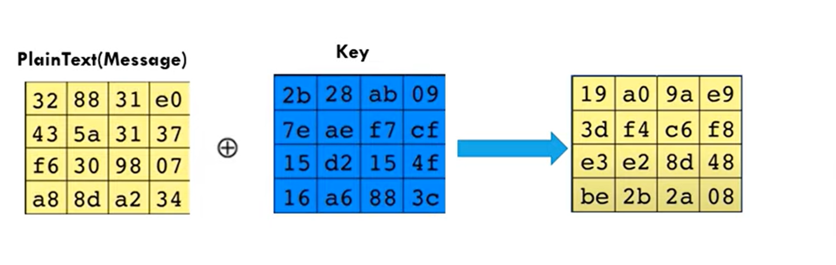
Initial Round - AddRoundKey
Description: XORs the plaintext with the initial round key
Explanation: This step combines the initial key with the plaintext to start the encryption process.

Slide 9
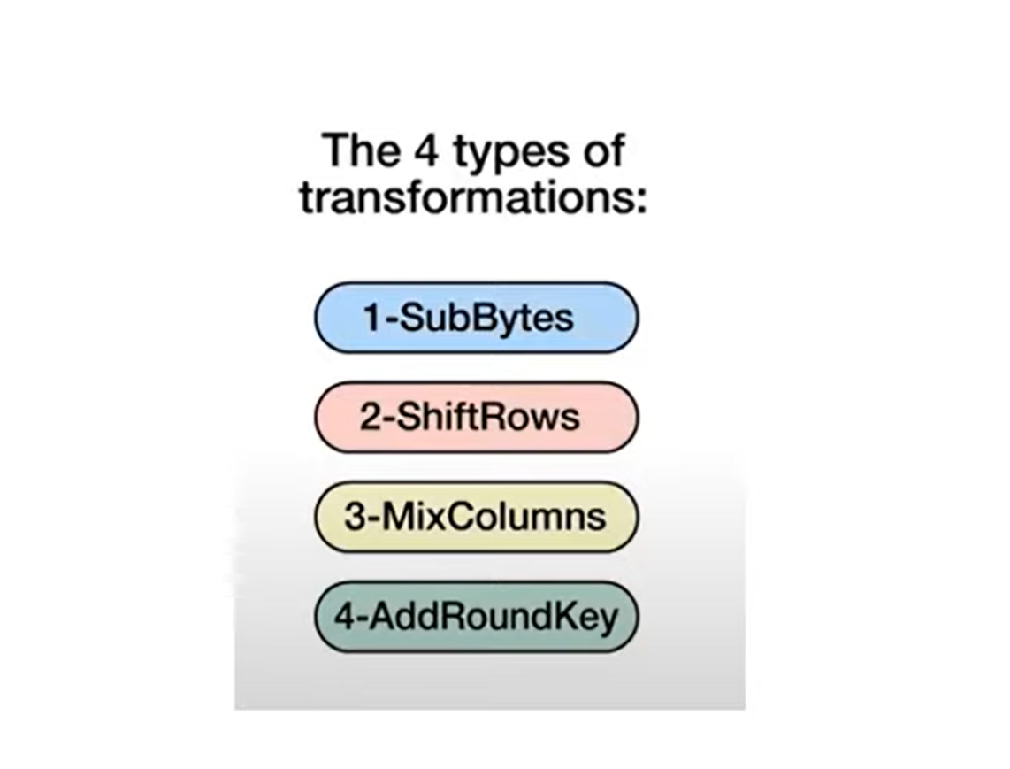
Main Rounds

Slide 10
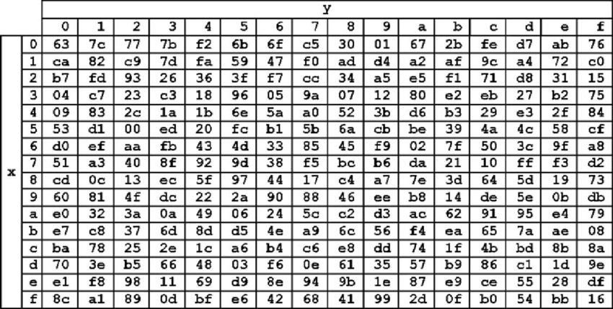
S-box

Slide 11
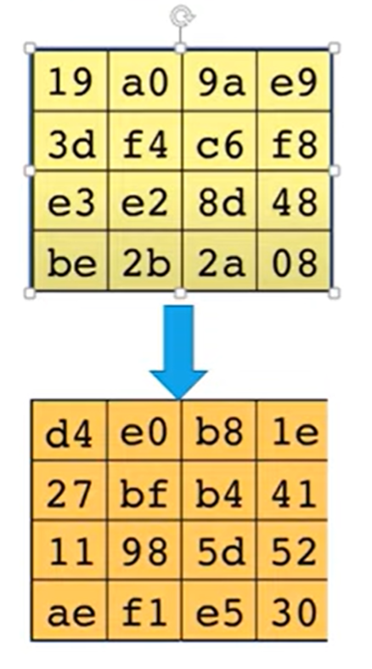
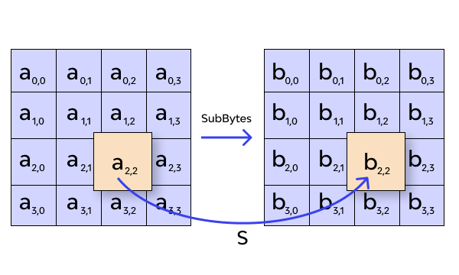
Main Rounds - SubBytes
Description: Non-linear substitution of bytes using a substitution box (S-box).
Purpose: Provides non-linearity in the cipher, making it resistant to linear and differential cryptanalysis.

Slide 12
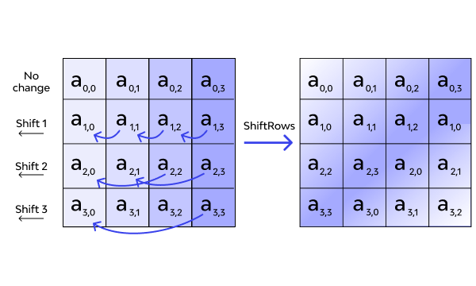
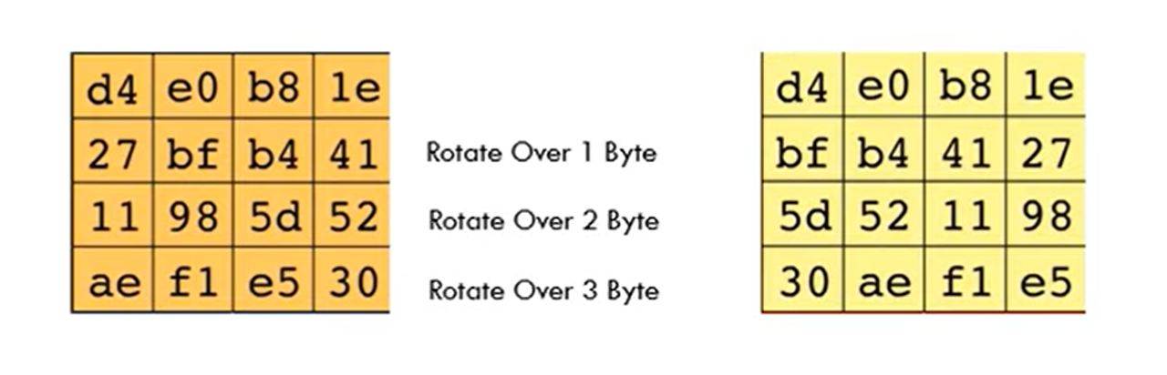
Main Rounds - ShiftRows
Description: Rows of the state matrix are cyclically shifted.
Purpose: Provides diffusion by ensuring that each byte in the state depends on multiple bytes in the plaintext.

Slide 13
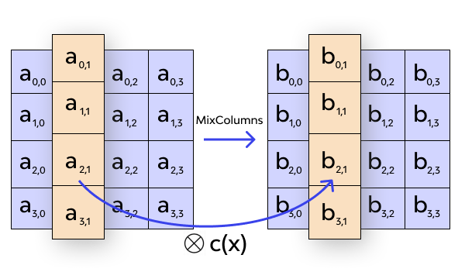
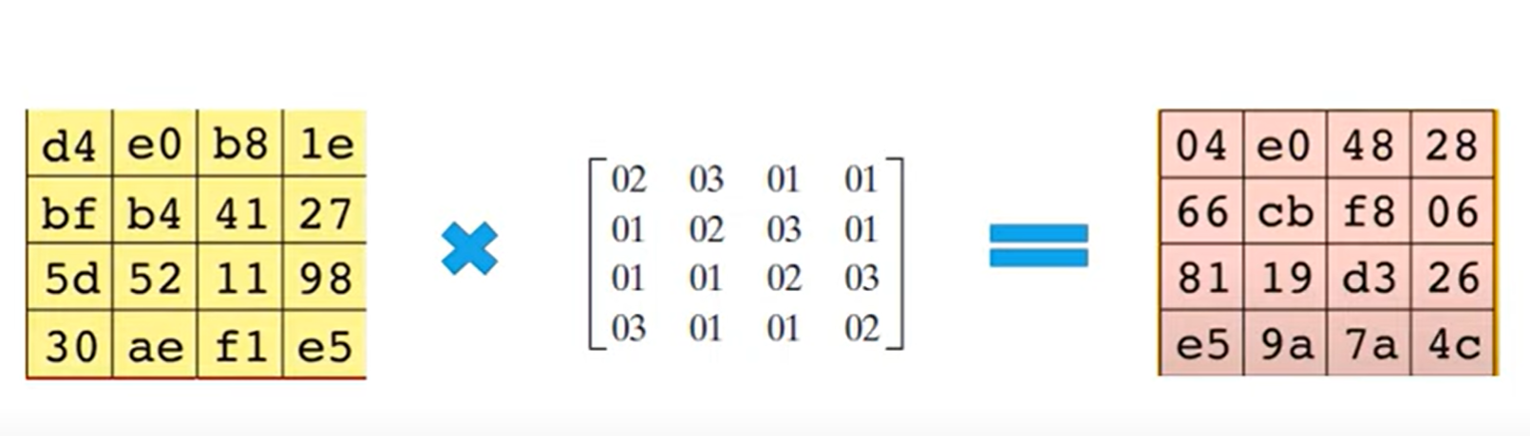
Main Rounds - MixColumns
Description: Columns of the state are treated as polynomials and mixed.
Purpose: Provides diffusion by mixing the bytes within each column.

Slide 14
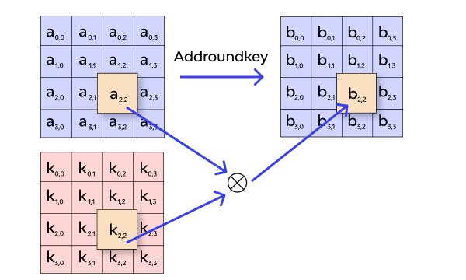
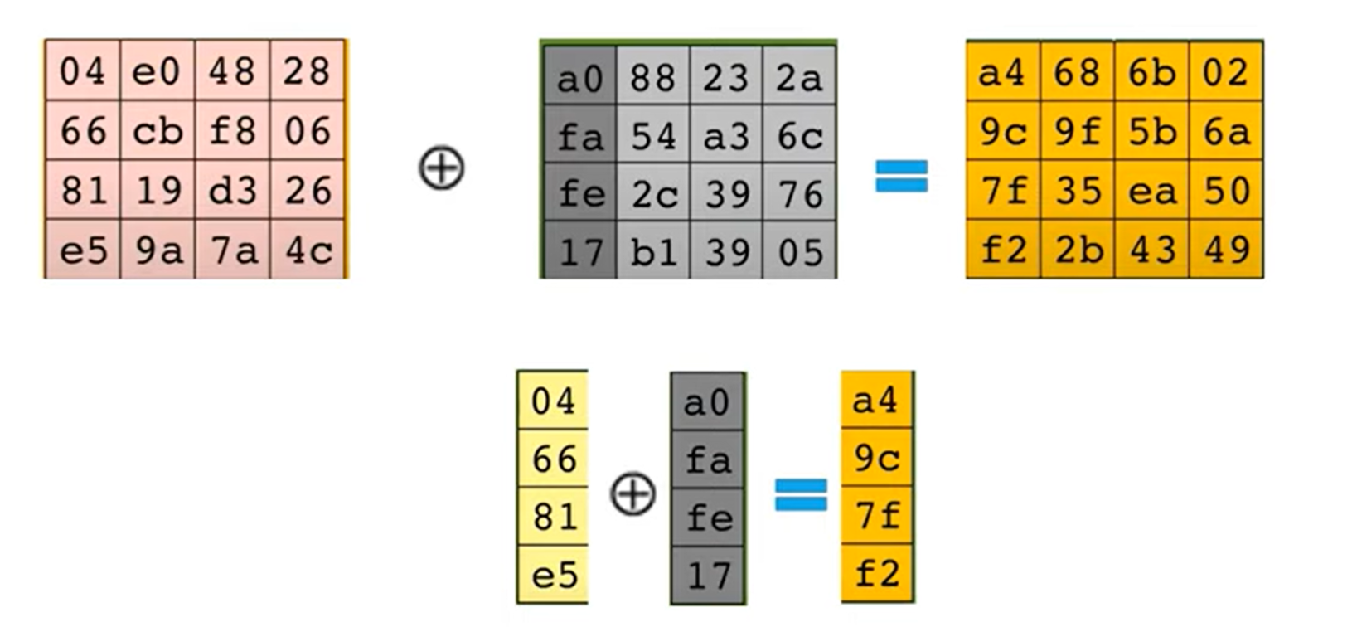
Main Rounds - AddRoundKey
Description: XORs each byte of the state with the corresponding byte of the round key.
Purpose: Adds key dependency to the transformation, ensuring that the encryption cannot be separated from the key.

Slide 15
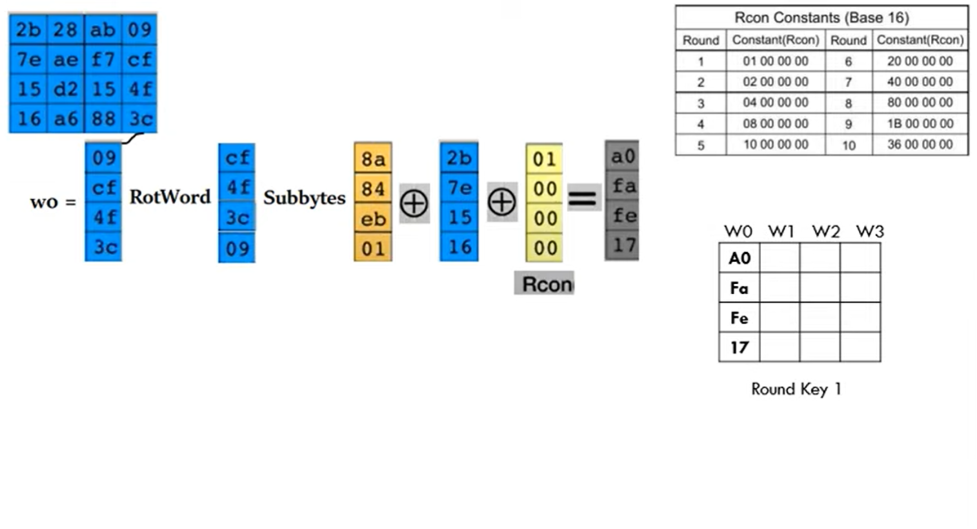
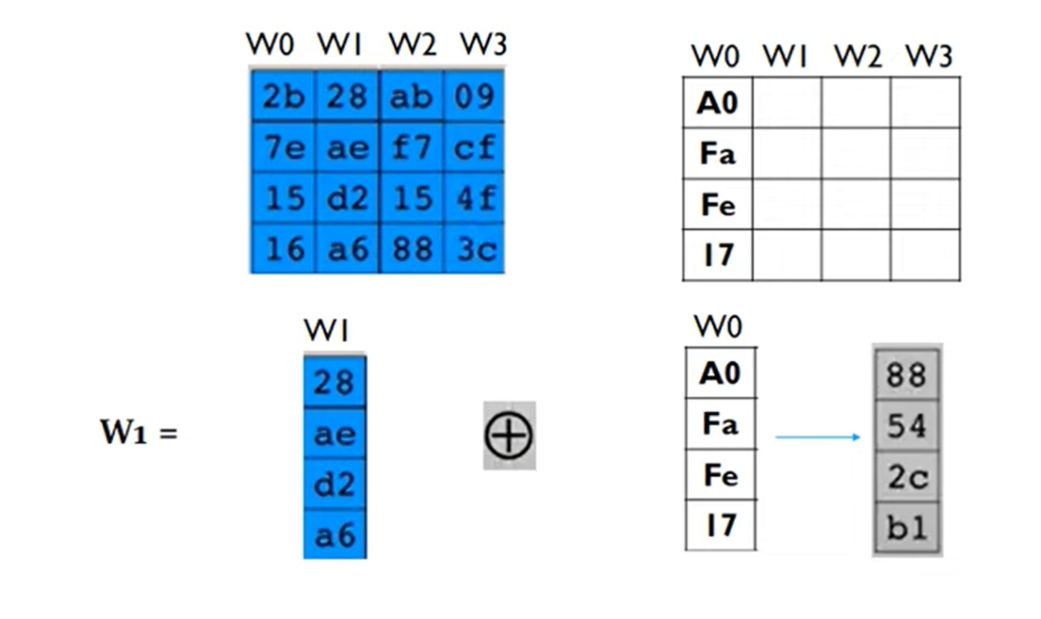
Key Expansion
steps
Description: Derives round keys from the cipher key.
Process:
RotWord: Rotates the bytes of a word.
SubWord: Applies the S-box to each byte.
Rcon: Adds a round constant.
XOR: Combines the transformed word with a word from the previous round key.

Slide 16
Final Round
Description: Similar to the main rounds but without the MixColumns step.
Steps:
SubBytes
ShiftRows
AddRoundKey

Slide 17
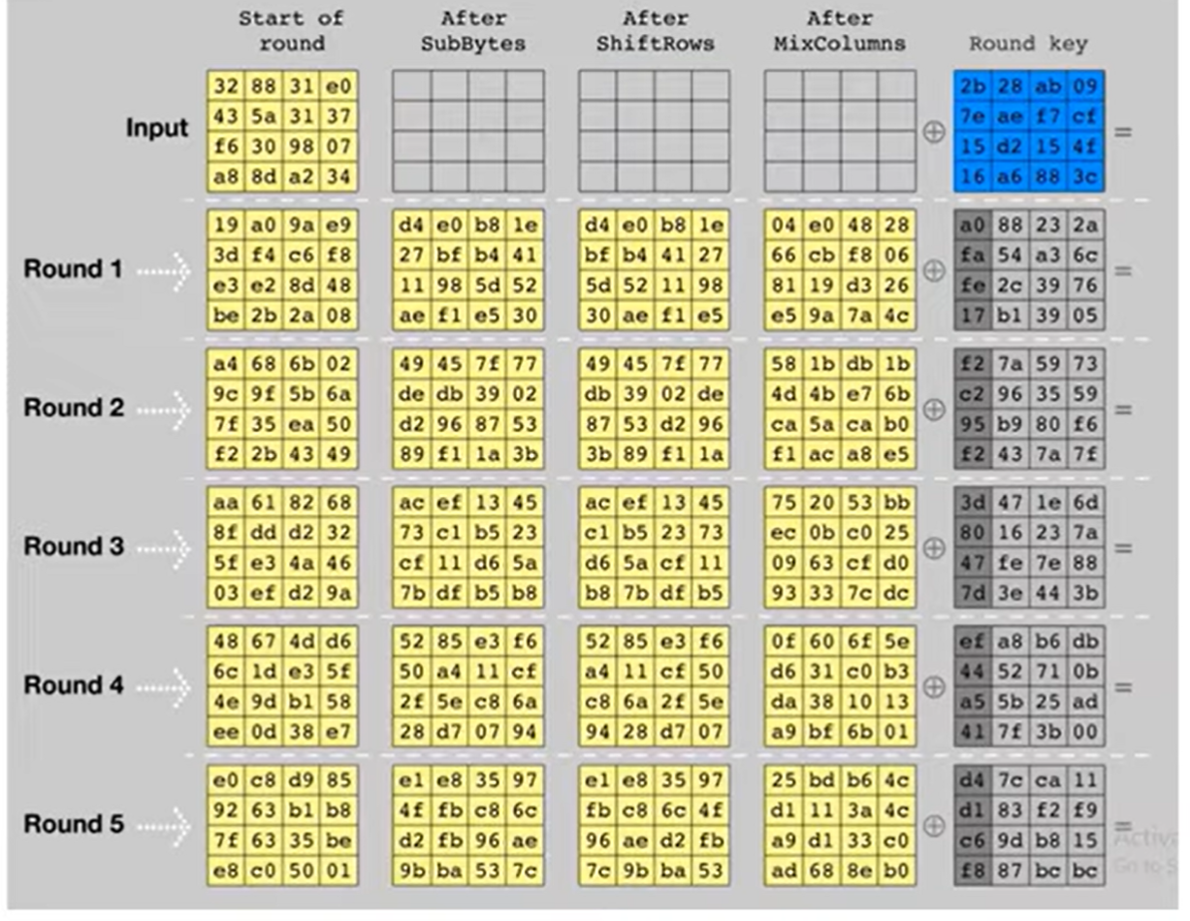
Output Ciphertext

Slide 18
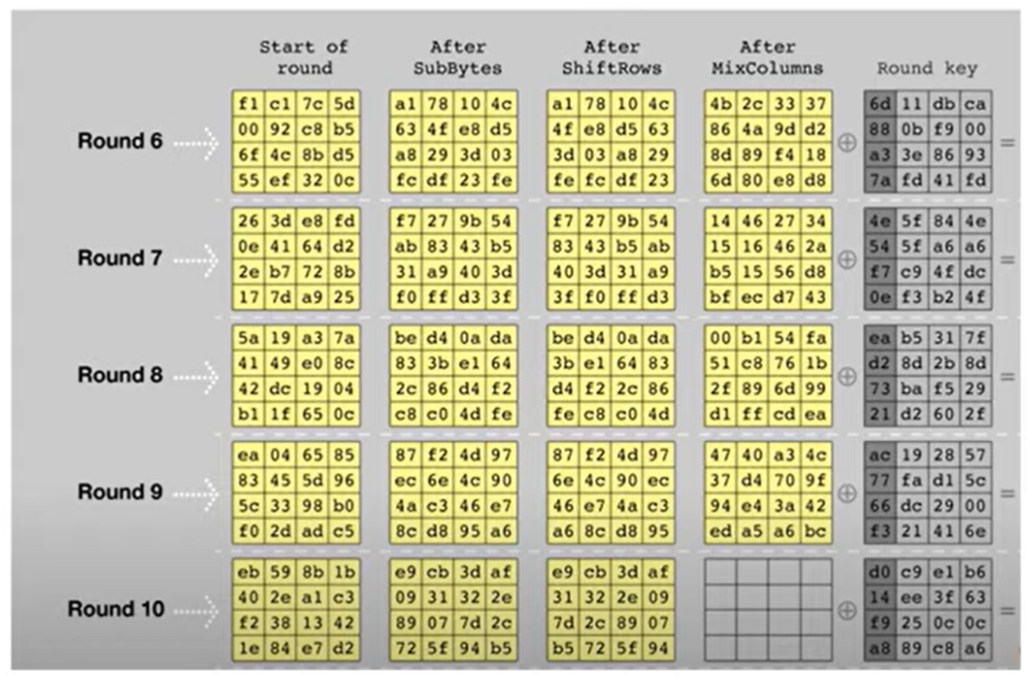
Output Ciphertext

Slide 19

Security of AES
Strength: AES is considered highly secure, resistant to all known practical attacks.
Vulnerabilities: No practical cryptanalytic attacks against full-round AES have been discovered.
Brute Force Resistance: Key size makes brute-force attacks infeasible (AES-128 requires 2^128 attempts).

Slide 20
Applications of AES
Secure Internet Communications: Used in protocols like SSL/TLS to secure web traffic.
Disk Encryption: Used in software like BitLocker and FileVault to encrypt disk data.
Wireless Security: Used in WPA2 for securing Wi-Fi networks.
VPNs: Used in various VPN protocols to secure communications.

Slide 21
Conclusion
Summary: AES is a robust, widely-used encryption standard crucial for data security.
Future: Continues to be a cornerstone of cryptographic security.

Slide 22

Thank you

